Slide 1
Introduction To SQL Programming
Database

Slide 2
Course objective
This course introduces basic concepts for database design.
Students will learn the main features of different DBMSs in the market.
It focuses on building ERD using practical case studies.
It explores how to build a relational database from the logical database design.
This course covers how to design, build and query a relational database.
They will apply normalization to data for effective, stable database design.
Students will learn basic concepts of Structured Query Language (SQL) .
Course Duration
3Days

Slide 3
Day1
DB Life cycle
File Based System & its Disadvantages and Limitations
DBMS Advantages & Disadvantages
ERD Notations
Entities & Attributes & relations
Keys & Constraints
Case Study

Slide 4
Day2
Mapping Definitions & Schema Rules
SuperTypes & SubTypes
Case Study
SQL Fundamentals
DDL
DML
DCL

Slide 5
Day3
SQL Part_II
Normalization
1NF
2NF
3NF
Case Study
Database Objects
Database backup and recovery
DB Security & Admin Roles
Log File and Transaction
OLAP & OLTP

Slide 6
Systems Development Life Cycle
Problem identification
Analysis
Logical Design
Physical Design
Mapping
Implementation
Testing & Maintenance

Slide 7
File Based System
Separation & Isolation Of data (each user has a copy) cause inconsistencies
Incompatible File Formats
Program-Data Dependence
All programs maintain metadata for each file they use
Each application program needs to include code for the metadata of each file
Non-standard file formats
Lengthy Development Times
Programmers must design their own file formats (Metadata)
Data Redundancy (Duplication of data)
Different systems/programs have separate copies of the same data
When data changes in one file, could cause inconsistencies
No Database integrity
Limited Data Sharing
No centralized control of data

Slide 8
Basic Definitions
Database: A collection of related data.
Database Management System (DBMS): A software package/ system to facilitate the creation and maintenance of a computerized database.(model introduced in 1970 IBM but RDBMS appears in1980)
Database System: The DBMS software together with the data itself. Sometimes, the applications are also included. ( Software + Database )

Slide 9
Database System
Users
Database System
Application Programs
Software to process
Queries
DBMS Software
Software to access Stored Data
Stored DB
Definition
(Metadata)
Stored
Database

Slide 10
DBMS Advantages
Standardization and better Data accessibility and response (SQL)
Sharing data.
Different users get different views of the data
Enforcing Integrity Constraints
Improved Data Quality
Constraints, data validation rules
Inconsistency can be avoided because of data sharing.
Restricting Unauthorized Access.
Providing Backup and Recovery.
Disaster recovery is easier
Minimal Data Redundancy
Leads to increased data integrity/consistency
Program-Data Independence
Metadata stored in DBMS, so applications don’t worry about data formats
Data queries/updates managed by DBMS

Slide 11
DBMS Disadvantages
It needs expertise to use
DBMS itself is expensive
The DBMS may be incompatible with any other available DBMS

Slide 12
Database Users
Database Administrator (DBA)
System Analysts
Database Designer
Database Developer
Application programmers
BI & BigData Specialist (Data Scientist)
End users

Slide 13
Three Level/Schema Architecture
A data model is a representation of reality
External – What the user sees: focus on what different types of users will see when viewing the database. They are concerned with what data the user will see and how the data will be presented to the user.
Conceptual – The logical model: focus on the logical nature of the data representation. They are concerned with what is represented rather than how it is represented.(define database structures such as tables and constraints)
Internal – The physical model: place the emphasis on how the data are represented in the database or on how the data structures are implemented.
Notes:
Database Model: a collection of logical constructs used to represent the data structure and the data relationships found within the database.
User models focus on what different types of users will see when viewing the database. They are concerned with what data the user will see and how the data will be presented to the user.
Logical models focus on the logical nature of the data representation. They are concerned with what is represented rather than how it is represented.
Physical models place the emphasis on how the data are represented in the database or on how the data structures are implemented.
External – What the user sees: deals with methods through which users may access the schema, such as through the use of a data input form. The external model allows relationships to be created between the user application and the data model.
Conceptual – The logical model: is the basic database model, which deals with organizational structures that are used to define database structures such as tables and constraints.
Internal – The physical model: deals with the physical storage of the database, as well as access to the data, such as through data storage in tables and the use of indexes to expedite data access. The internal model separates the physical requirements of the hardware and the operating system from the data model.

Slide 14
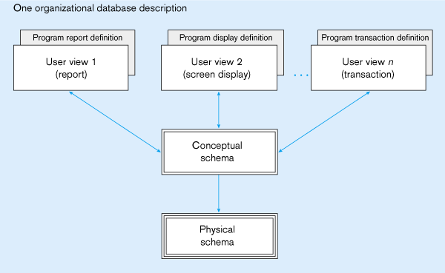
Three Level/Schema Architecture
External schema
Different people have different views of the database…these are the external schema
Internal schema

Slide 15
Entity Relationship Diagram Concepts

Slide 16
Entity Relationship Modeling
Entity-Relationship Diagram (ERD)
identifies information required by the business by displaying the relevant entities and the relationships between them.

Slide 17
The ER Model
Basic constructs of the E-R model:
Entities - person, place, object, event, concept (often corresponds to a real time object that is distinguishable from any other object)
Attributes - property or characteristic of an entity type (often corresponds to a field in a table)
Relationships – link between entities (corresponds to primary key-foreign key equivalencies in related tables)

Slide 18
ER Diagram: Starting Example
access-date
cust-name
number
cust-id
has
customer
account
cust-street
cust-city
balance
Rectangles: entity sets
Diamonds: relationship sets
Ellipses: attributes

Slide 19
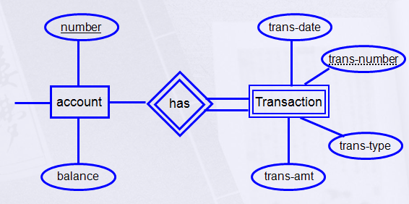
Strong Entity Vs Weak Entity
A Strong Entity- An Entity set that has a primary key.
A Weak Entity- An entity set that do not have sufficient attributes to form a primary key.
Partial key: A set of attributes that can be associated with P.K of an owner entity set to distinguish a weak entity.
Notes:
Weak entity
An entity that does not have a key attribute
A weak entity must participate in an identifying relationship type with an owner or identifying entity type
Entities are identified by the combination of:
A partial key of the weak entity type
The particular entity they are related to in the identifying entity type
Example:
Suppose that a DEPENDENT entity is identified by the dependent’s first name and birth date, and the specific EMPLOYEE that the dependent is related to. DEPENDENT is a weak entity type with EMPLOYEE as its identifying entity type via the identifying relationship type DEPENDENT_OF

Slide 20
Next: Types of Attributes
Composite Attribute
Multi-valued Attribute
Derived Attribute
Complex Attribute
Simple Attribute

Slide 21
Simple Attribute
access-date
cust-name
number
cust-id
has
customer
account
cust-street
cust-city
balance

Slide 22
Composite Attribute
First
Last
number
Name
has
date-of-birth
customer
account
balance
month
day
year

Slide 23
Derived Attribute
age
number
date-of-birth
has
Emp
account
Salary
Deduction
Net Salary
balance
derived (dashed ellipse)

Slide 24
Multi-valued
number
address
has
customer
account
phone no.
balance
multi-valued (double ellipse)

Slide 25
Complex Attribute
Street
City
Country
number
address
has
customer
account
balance
multi-valued + Composite

Slide 26
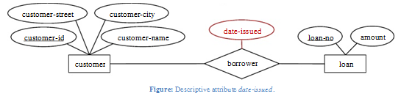
Relationship
A Relationship is an association among several entities.
A relationship may also have attributes
For example, consider the entity sets customer and loan and the relationship set borrower. We could associate the attribute date-issued to that relationship to specify the date when the loan was issued.

Slide 27
Relation
Relation has three Properties:
Degree of Relationships
Cardinality Constraint
Participation Constraint

Slide 28
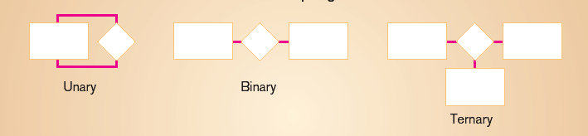
Degree of Relationships
Degree: number of entity types that participate in a relationship
Three cases
Unary: between two instances of one entity type
Binary: between the instances of two entity types
Ternary: among the instances of three entity types

Slide 29
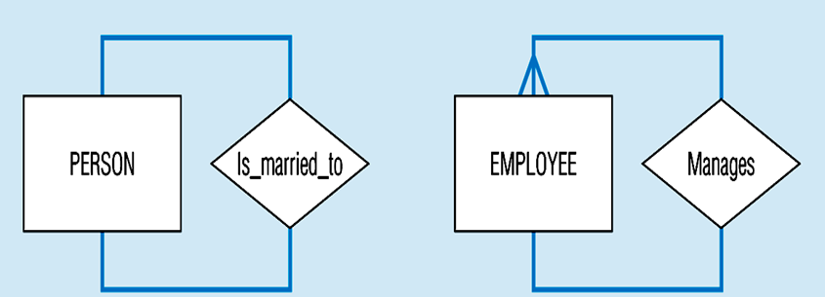
Recursive Relationship (Unary)
Recursive Relationships - A relationship in which the same entity participates more than once.

Slide 30
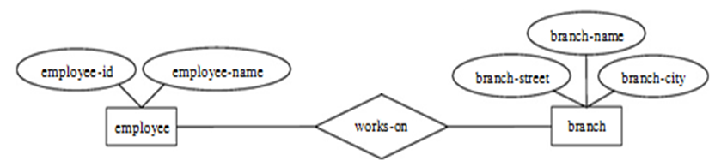
Binary Relationship
A binary relationship set is of degree 2.

Slide 31
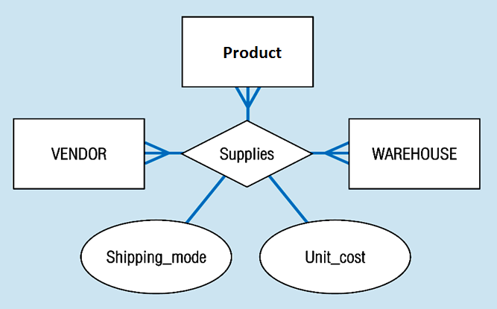
Ternary Relationship
ternary relationship set is of degree 3.

Slide 32
Cardinality
How many instances of one entity will or must be connected to a single instance from the other entities.
One-One Relationship
One-Many Relationship
Many- Many Relationship
Notes:
Relationship: Establishes a connection or correspondence or link between a pair of tables in a database, or between a pair of entities in an entity-relationship diagram (ERD).
One-to-one relationship: A single record in table A is related to only one record in table B, and vice versa.
One-to-many relationship: A single record in table A can be related to one or more records in table B, but a single record in table B can be related to only one record in table A.
Many-to-many relationship: A single record in table A can be related to one or more records in table B, and vice versa. Problems with many-to-many relationships: one of the tables will contain a large amount of redundant data, both tables will contain some duplicate data, it will be difficult to add, update, delete records because of the duplication of fields between tables.

Slide 33
Mapping Cardinalities
One-to-One
One-to-Many
Many-to-Many
1
own
1
Employee
Car
1
has
M
Department
Employee
M
take
M
Course
Student

Slide 34
PARTICIPATION CONSTRAINT
An employee MUST work for a department An employee entity can exist only if it participates in a WORKS_FOR relationship instance So this participation is TOTAL Only some employees manage departments The participation is PARTIAL

Slide 35
PARTICIPATION CONSTRAINT
Has
Employee
Car
An Employee may have a car.
A Car must be assigned to particular employee

Slide 36
PARTICIPATION CONSTRAINT
Hire
Department
Employee
- A department may hire many employees ( Zero or more)
An employee must be employed by a department
(Department membership is Optional, Employee membership is Mandatory)

Slide 37
PARTICIPATION CONSTRAINT
Has
Employee
(0,1)
(1,1)
Car
work
Employee
(1,1)
(1,N)
Dept
A formal constraint: (min,max) where m, n are min and max number of times an entity participates in a relationship instance. For example, (0,10) means partial participation, and (1,max) means total participation.

Slide 38
Keys
Different Types of Keys:
Candidate Key
Primary Key
Foreign Key
Composite Key
Partial Key
Alternate key
Super Key

Slide 39
Candidate Key
Candidate key: is a set of one or more attributes whose value can uniquely identify an entity in the entity set
Any attribute in the candidate key cannot be omitted without destroying the uniqueness property of the candidate key.
Example:
(SSN, Name) is NOT a candidate key .
“SSN” is a candidate key of customer.
Candidate key could have more than one attributes.
Notes:
It is minimal super key.
,
because taking out “name” still leaves “SSN” which can uniquely identify an entity.

Slide 40
Primary Key
Example: Both “SSN” and “License #” are candidate keys of Driver entity set.
Primary Key: is the candidate key that is chosen by the database designer as the unique identifier of an entity.
[Unique & Not Null]
Primary key May be Composite
Notes:
In building a database in a database software, the software will only allow to use one candidate key to be the unique identifier of an entity for an entity set.

Slide 41
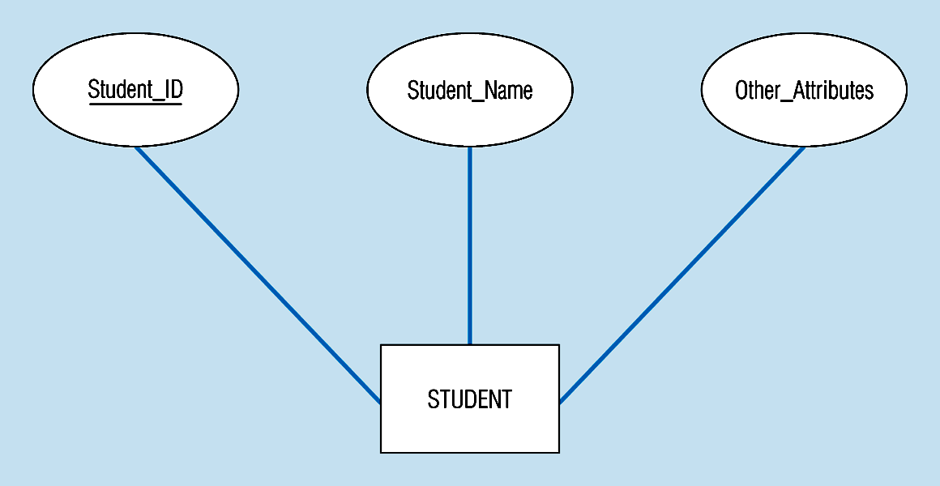
Primary Key
The key is underlined
Notes:
In building a database in a database software, the software will only allow to use one candidate key to be the unique identifier of an entity for an entity set.

Slide 42
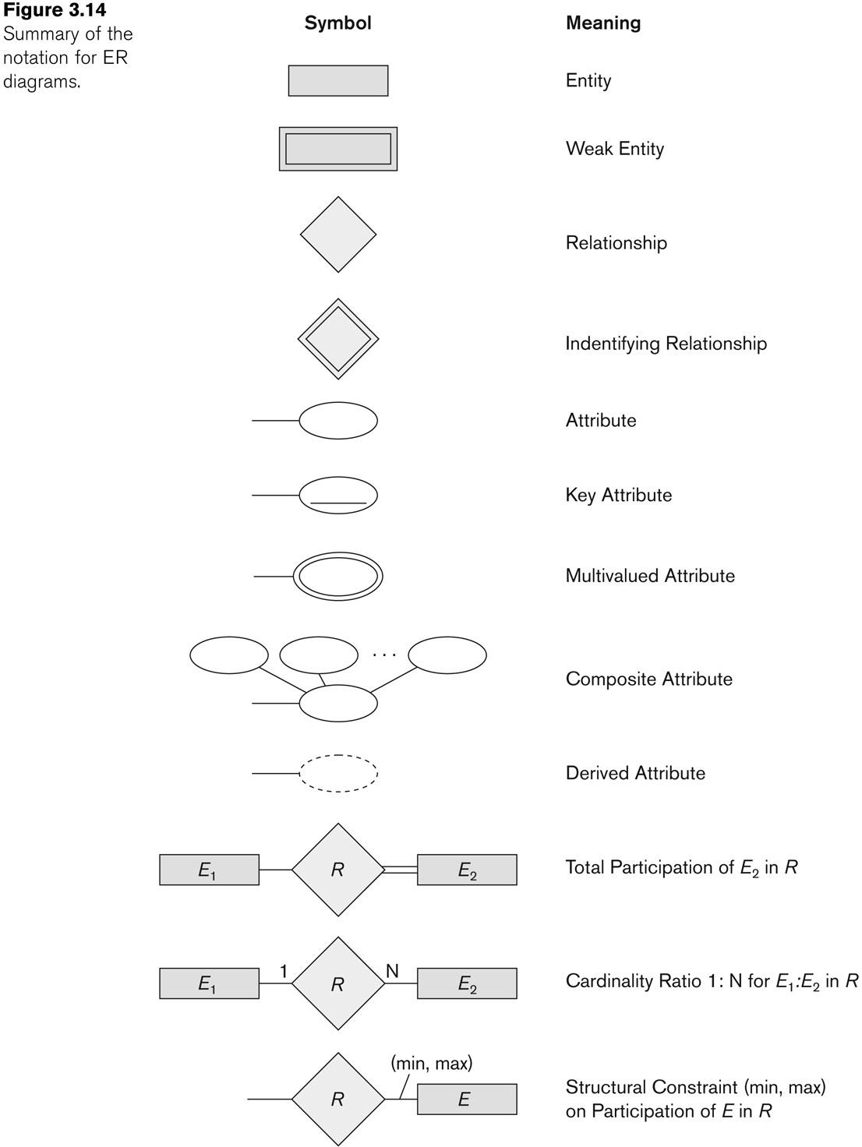
Summary of notation for ER diagrams
Identifying relationship is links strong entities to weak entities and represented with double line diamond

Slide 43
Case Study

Slide 44
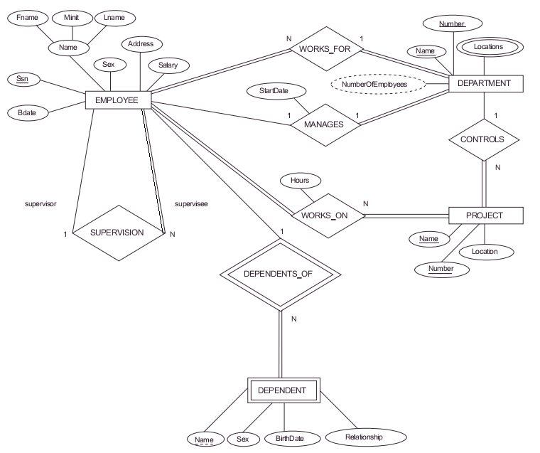

Slide 45
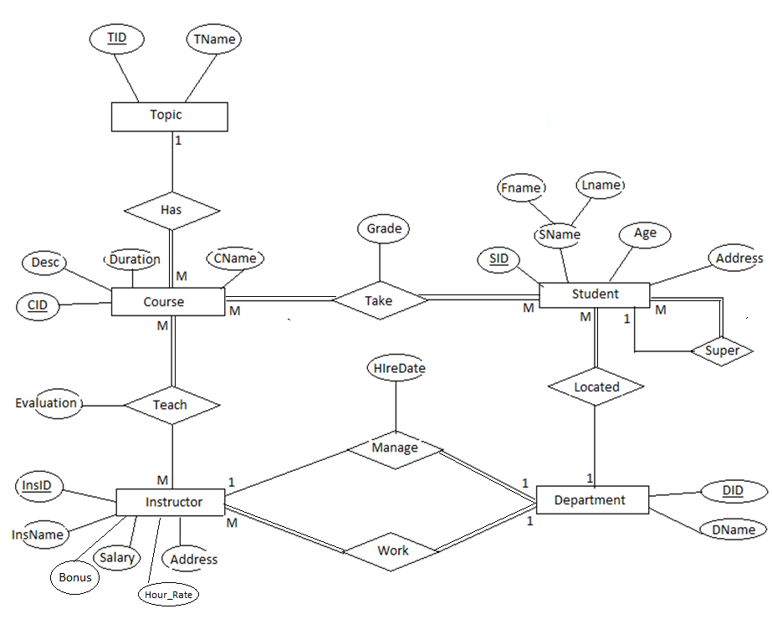

Slide 46
Thank You !!!

